Slide 1
Team Pegasus
Final Project

Slide 2

ATTENDANCE MANAGEMENT SYSTEM
Our team hereby presents an Attendance Management System which is deployed on the cloud using services provided by Google Cloud Platform on its cloud service Firebase.
The aim of the project was to develop a simple web application which is designed to be deployed on the Cloud using services like hosting and
Realtime Database Management.

Slide 3
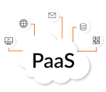
Agenda :
The aim of the project is to make an attendance management system that is highly flexible enough to adjust according to user and their usage.
The agenda is to create an attendance system which is simple, minimal and yet highly efficient in the purpose it is meant for.
The design in mind of the team was successfully implemented in the form of a web app which is hosted on the cloud as a solution. The cloud services such as PaaS are used to implement the solution and distribute it to the users.

Slide 4
PROBLEM STATEMENT :
To develop a Cloud based solution for an Attendance Management platform using PaaS (Platform as a Service).

Slide 5
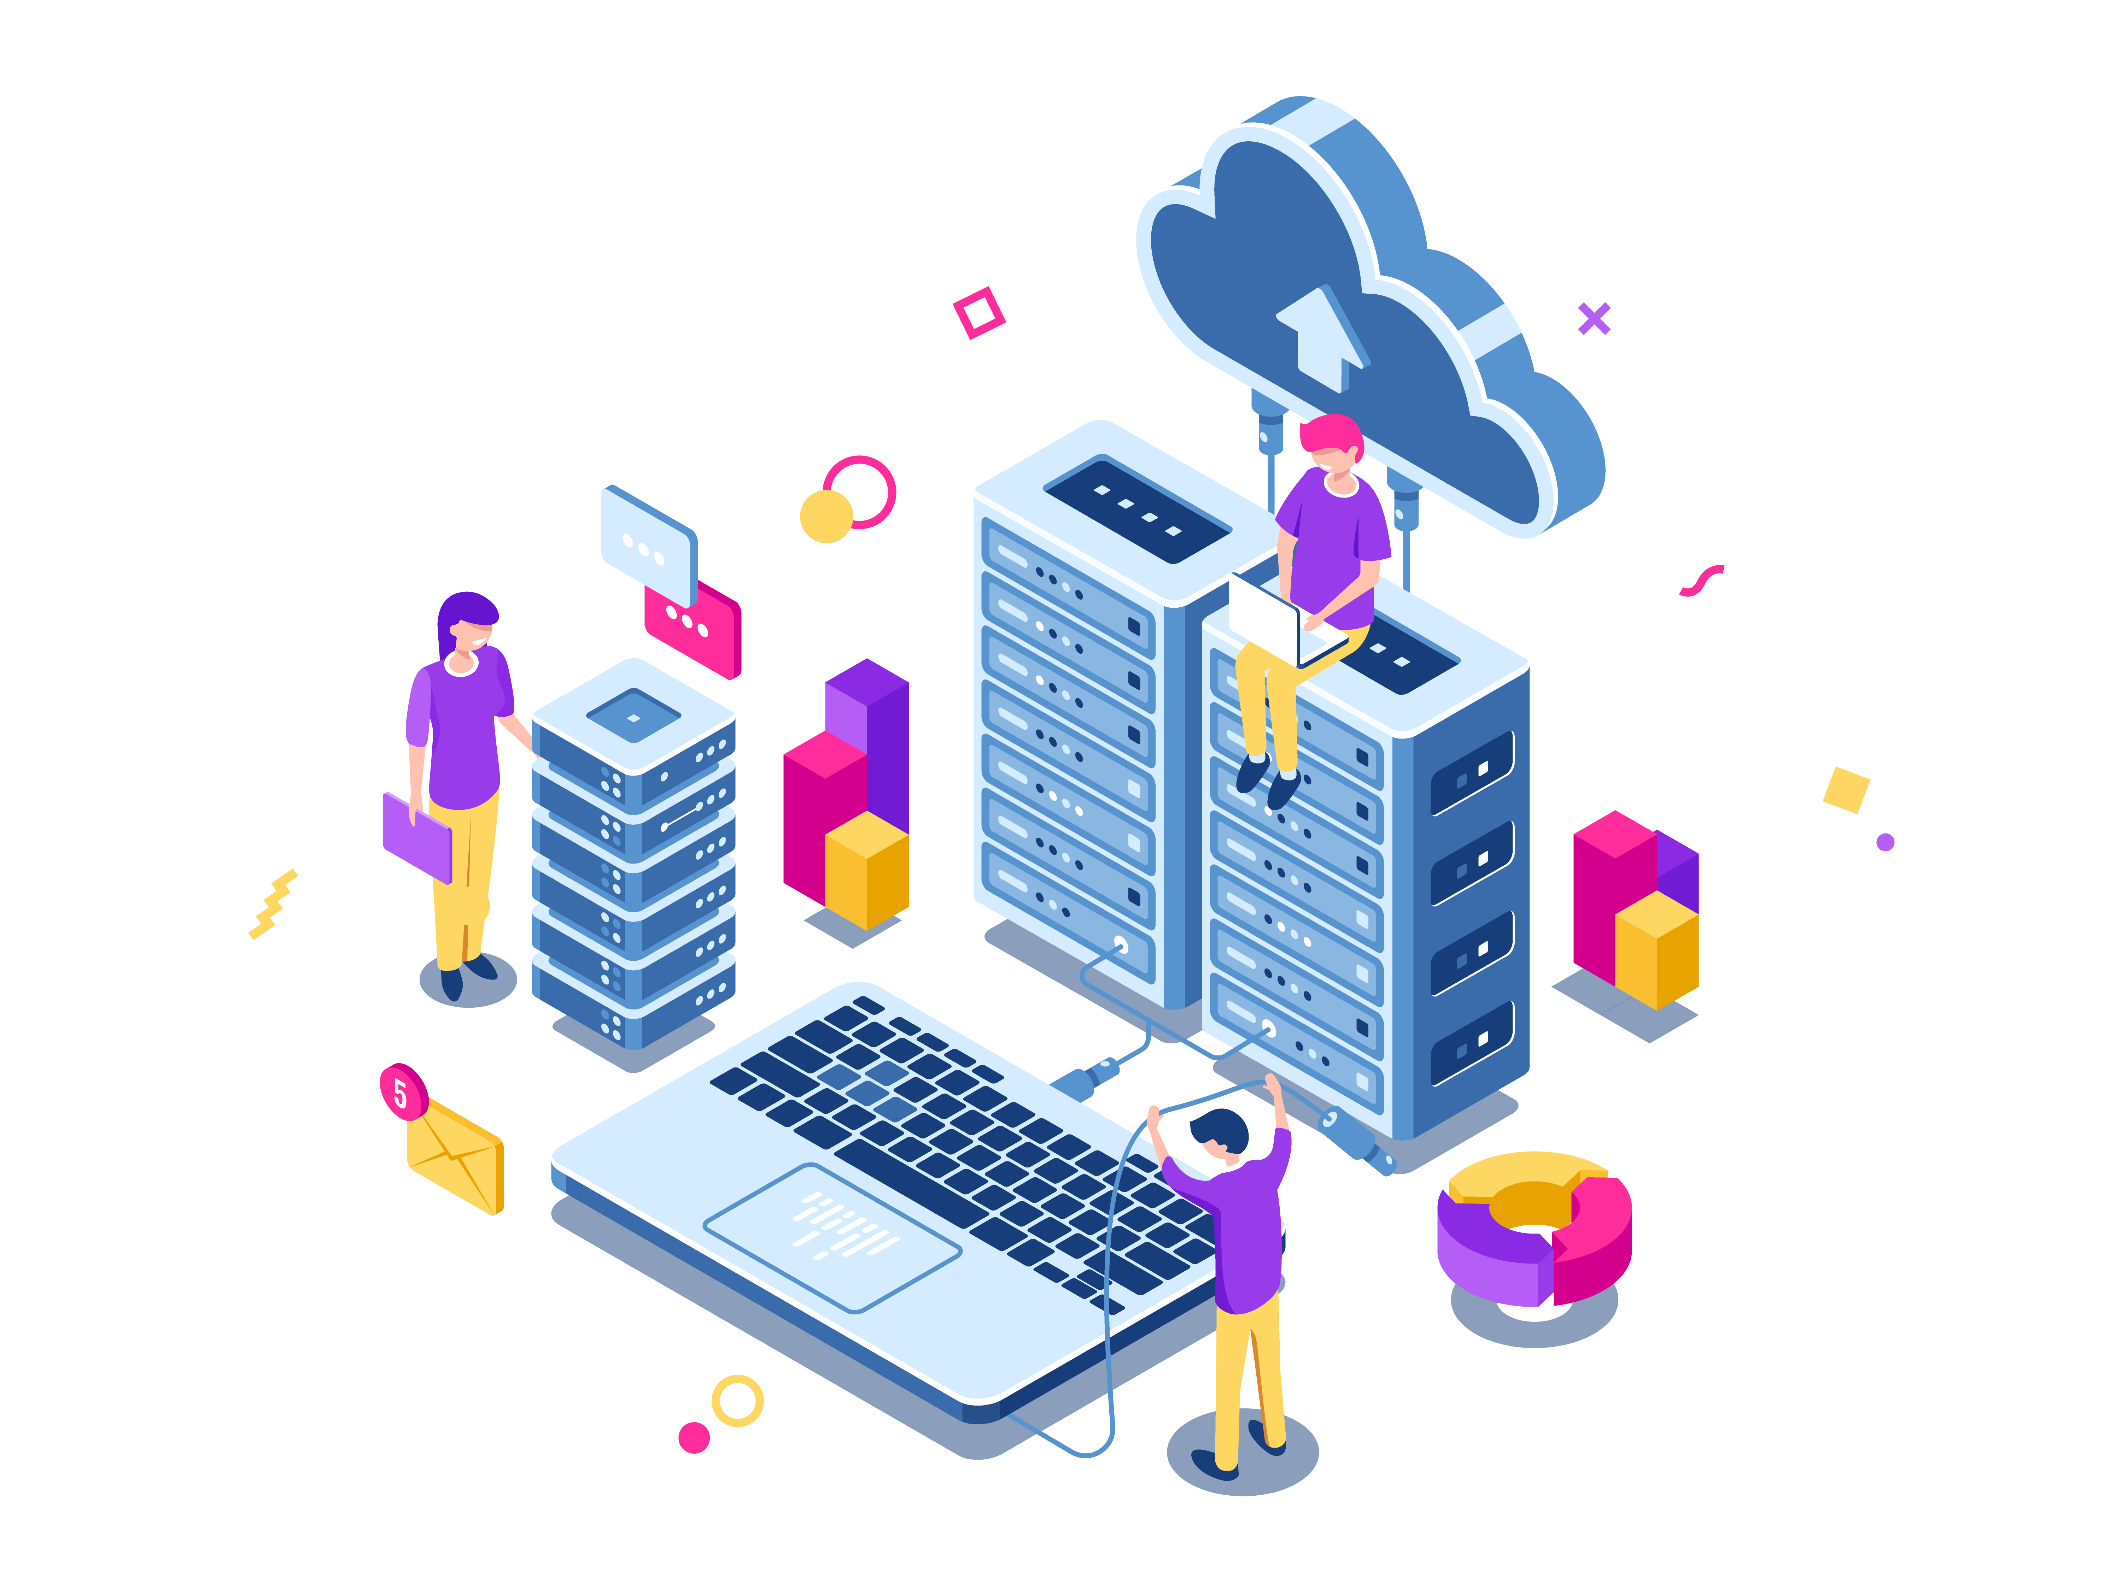
PROJECT OVERVIEW:
The project was categorized into several stages including :
Project Problem Statement Decision
Solution Designing
Solution Implementation

Slide 6

WHO ARE THE END USERS?

Slide 7

Corporations and Multinational Companies who have an abundance of employees and their attendance data to be maintained on a daily basis.
Government employees require such platform applications in order to digitize their employee’s attendance data.
Educational institutions can also use this platform to maintain the attendance of their students and faculty staff.
Indian Railways Reservation Ticket Collectors.

Slide 8

OUR SOLUTION AND ITS VALUE proportion

Slide 9

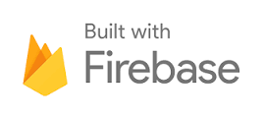
We would like to develop a cloud based solution in the form of a full stack website which can store attendance data in the form of a database in the cloud. The data from the database is retrievable from the cloud using API gateways working in the background.
We will be using the following PaaS services available in Firebase :
Google Cloud Platform (GCP) Firebase Hosting
Google Cloud Platform (GCP) Firebase
Realtime Database

Slide 10
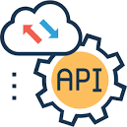
The wow in our solution!
The framework is designed in a manner to support API data fetching not locally but from a Realtime Database supported by Google Firebase using APIs.
The management platform is flexible enough to support various different categories of use cases for example it is adjustable to educational attendance management as well as for a ticket collector in a train.

Slide 11
Modelling

Slide 12
USERFLOW DIAGRAM:

Slide 13
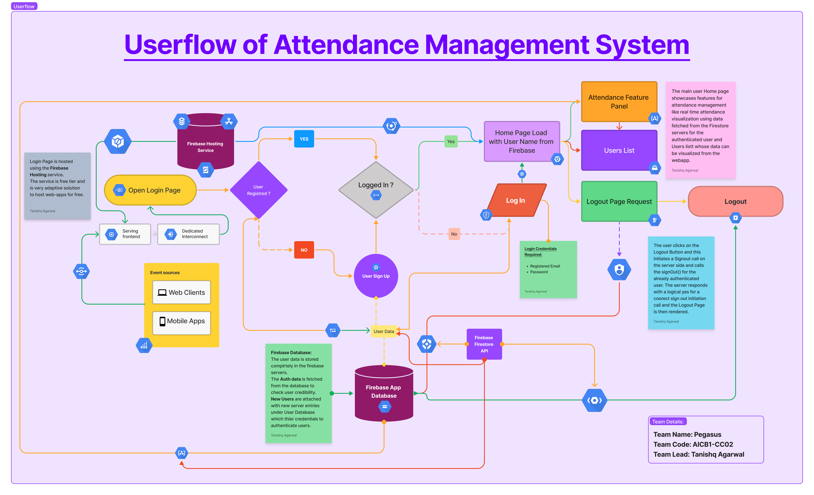

Slide 14
WIREFLOW:

Slide 15
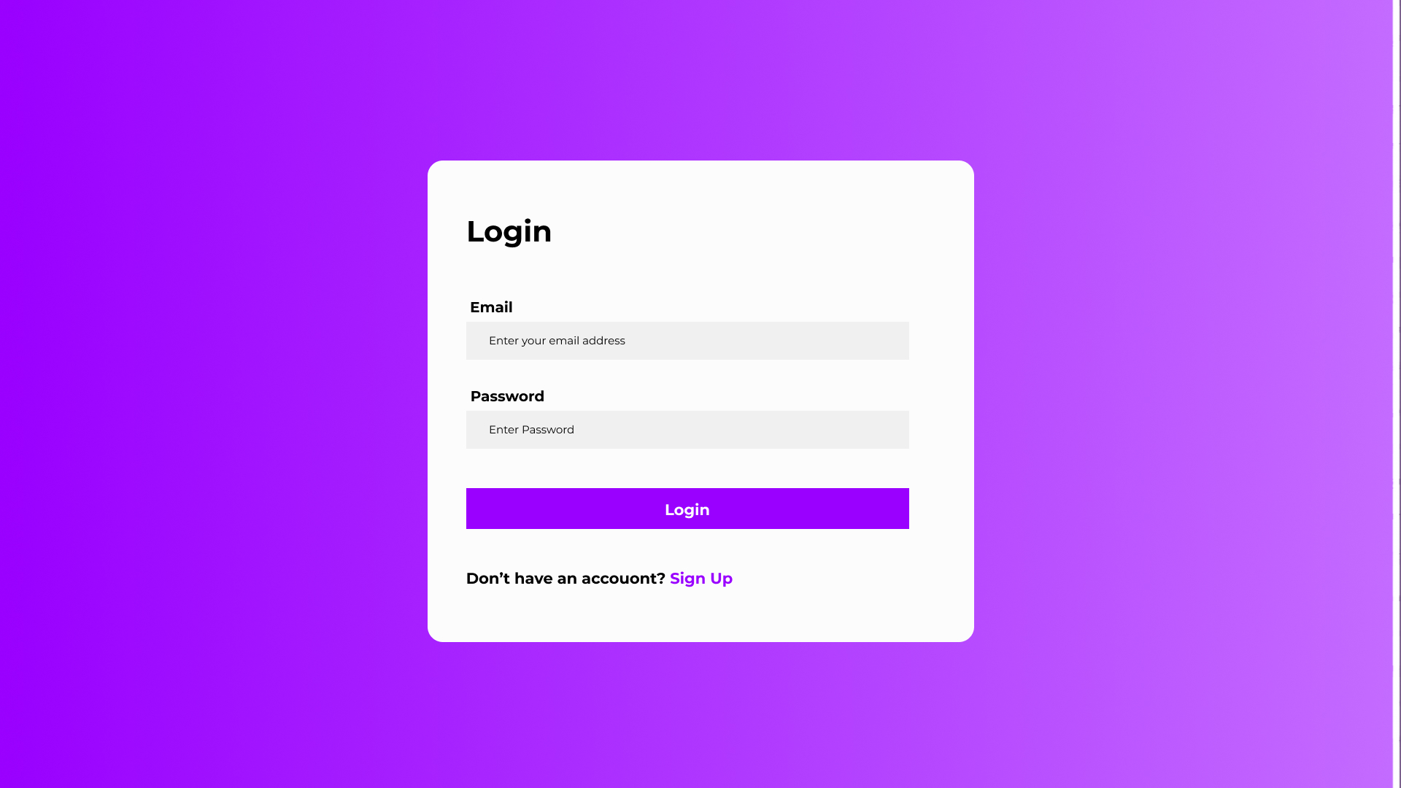
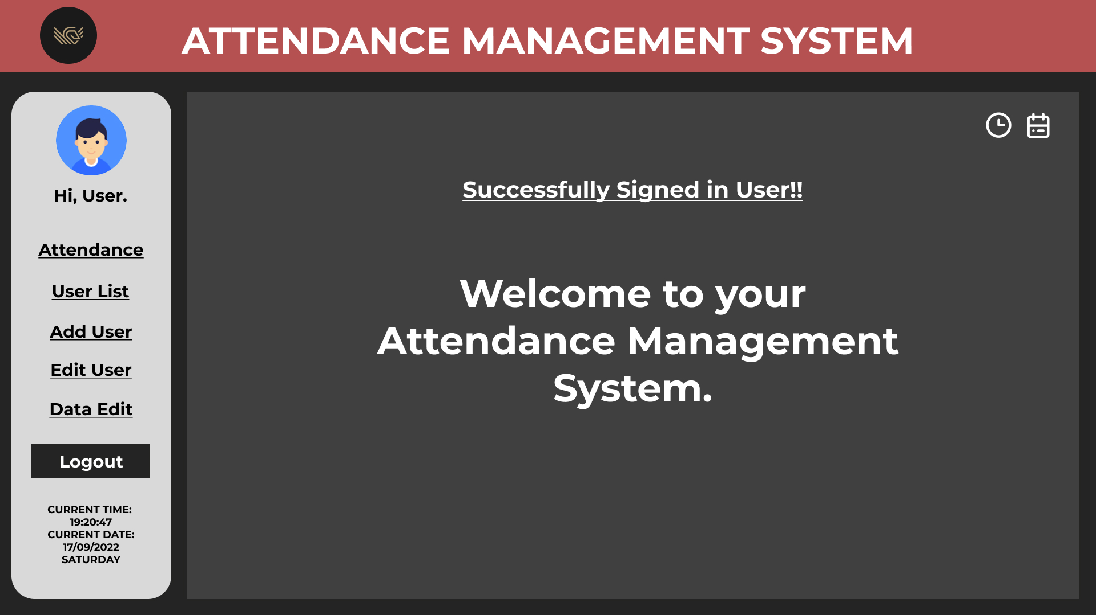
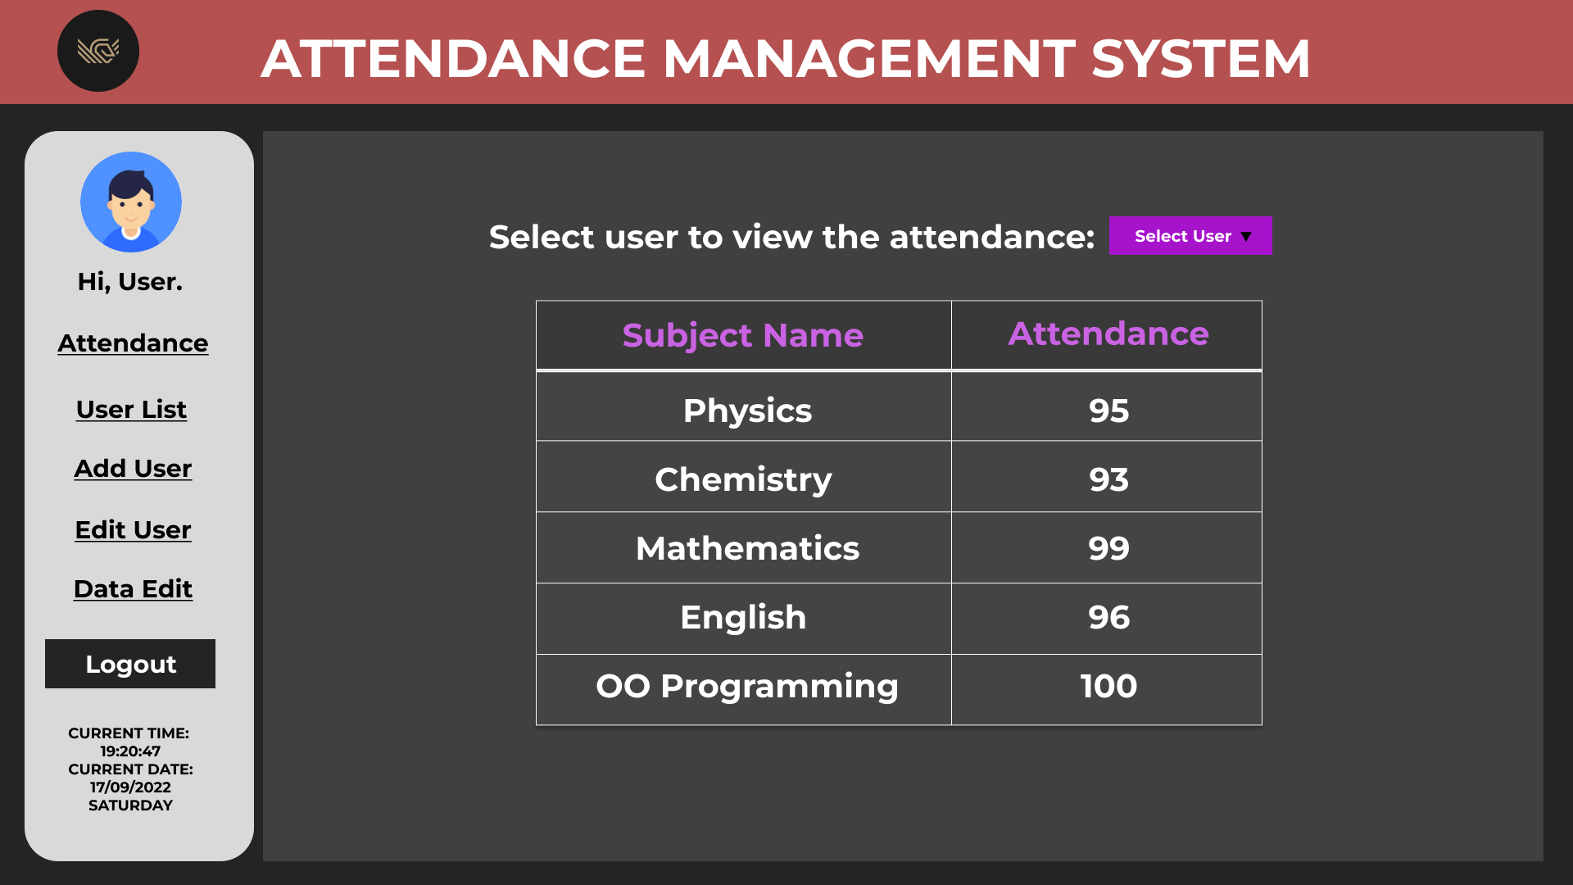
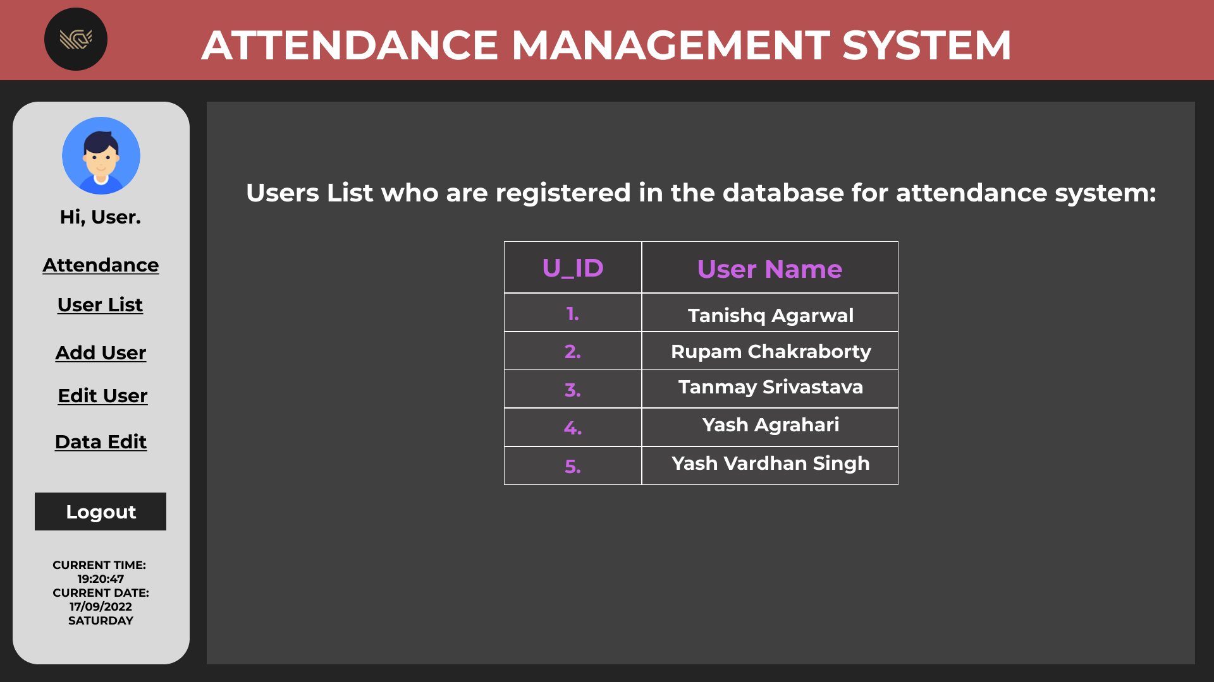
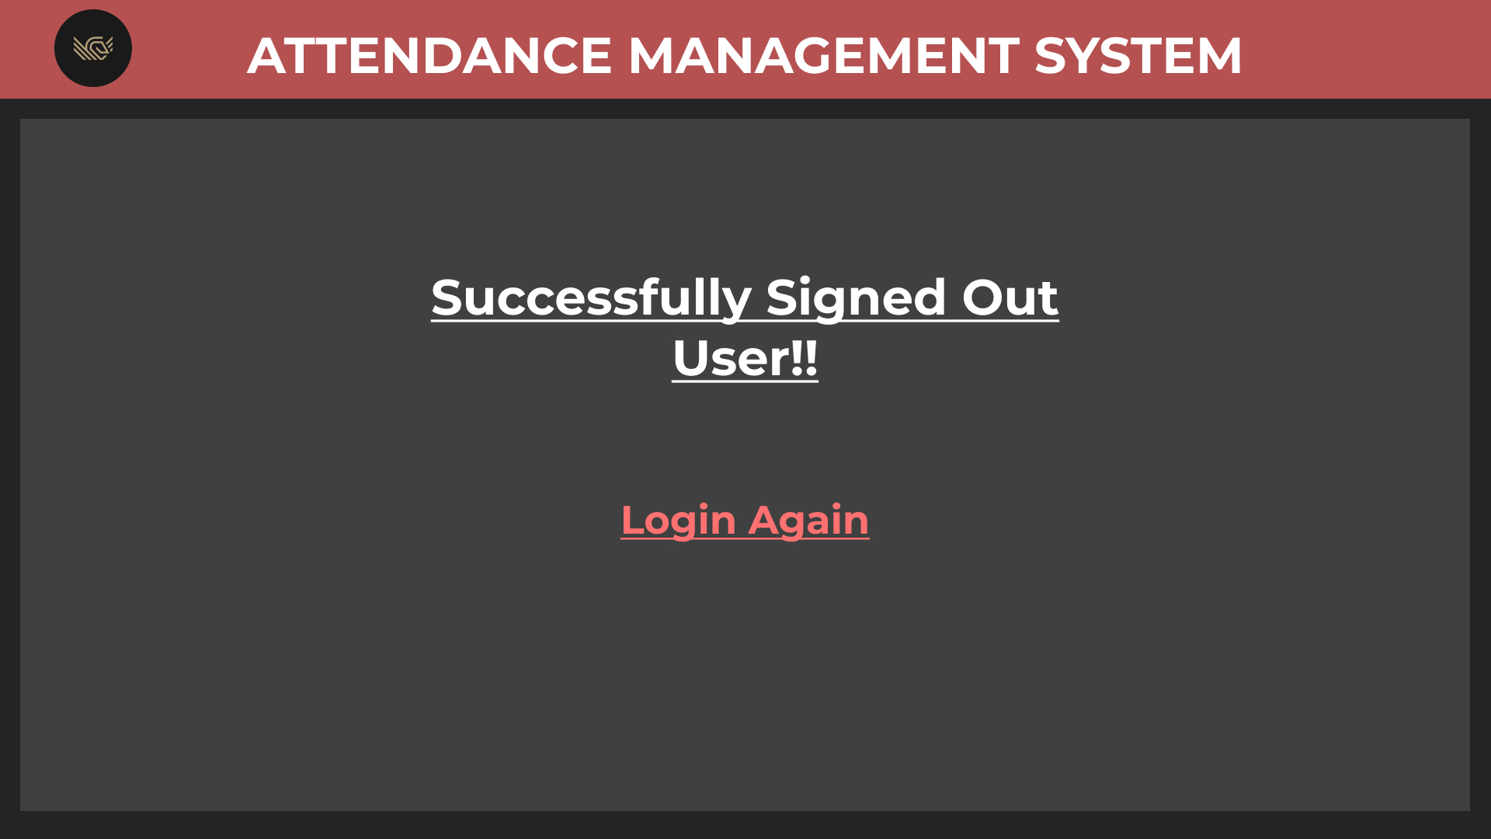
Login Page
Attendance System
Home Page
Attendance Management
Page
User List Page
Logout Page

Slide 16

Results :
One can access our project from the public GitHub repository available along with the project’s source code at the link below :
https://github.com/047pegasus/AttendanceManagementSystem
The project was successfully implemented with all functionalities working as they should and overall results were excellent and were deployed without any problems as far.

Slide 17



Meet our team
Tanishq Agarwal (Team Lead)
Rupam Chakraborty
Abhinash
Kasturi Satwik

Slide 18

THANK YOU!!

